Slide 1

FOURTH QUARTILE
Designing for an Active Transition into a Retirement Lifestyle
Adam Barry, Amy Chang, Ethan Hellman, Brendan McLoughlin
CS 147 · F23 · Stanford University

Slide 2
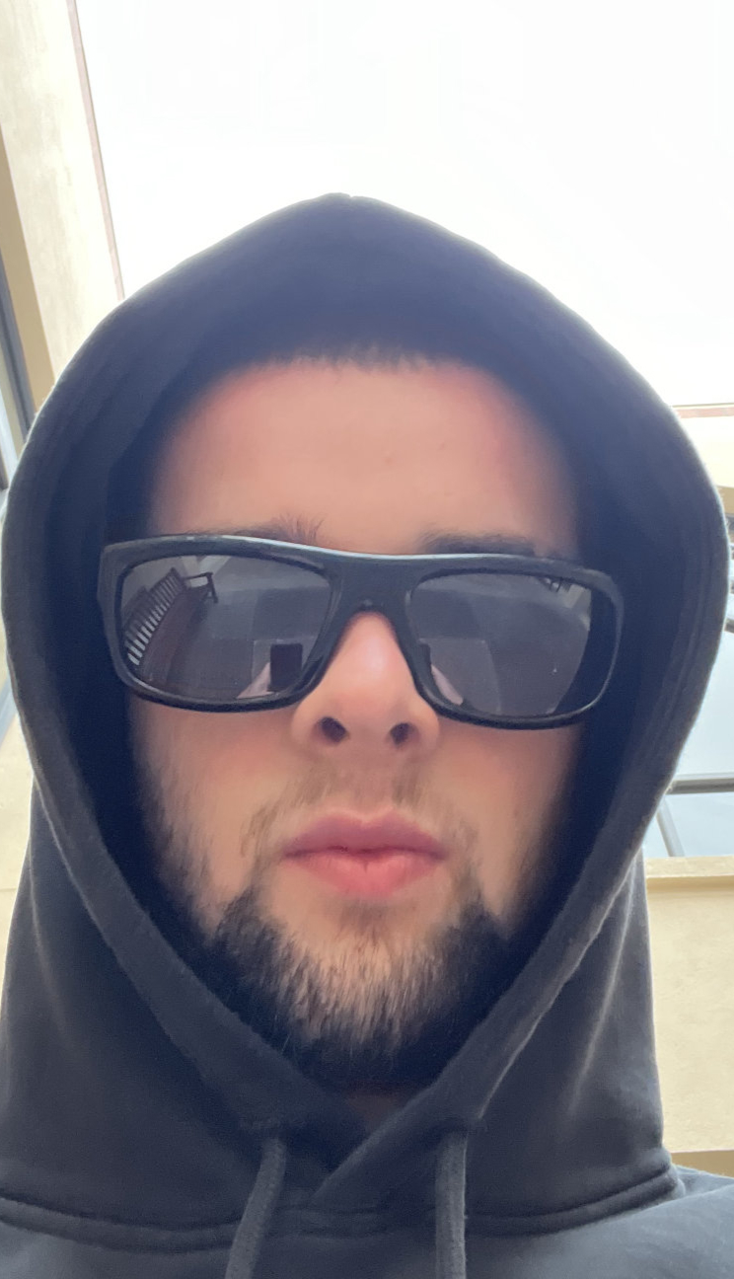
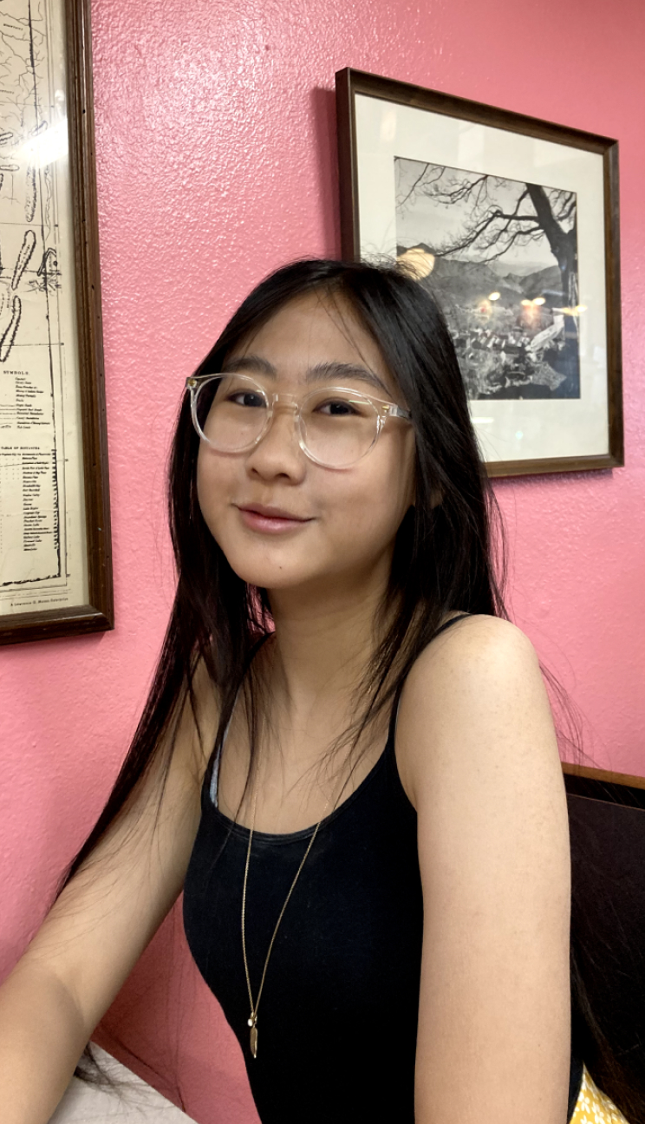
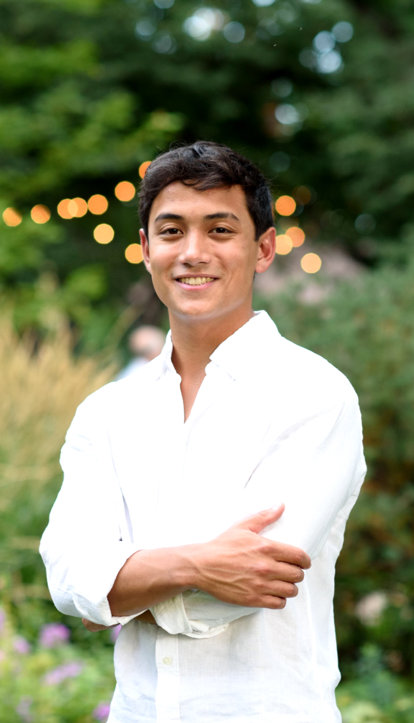
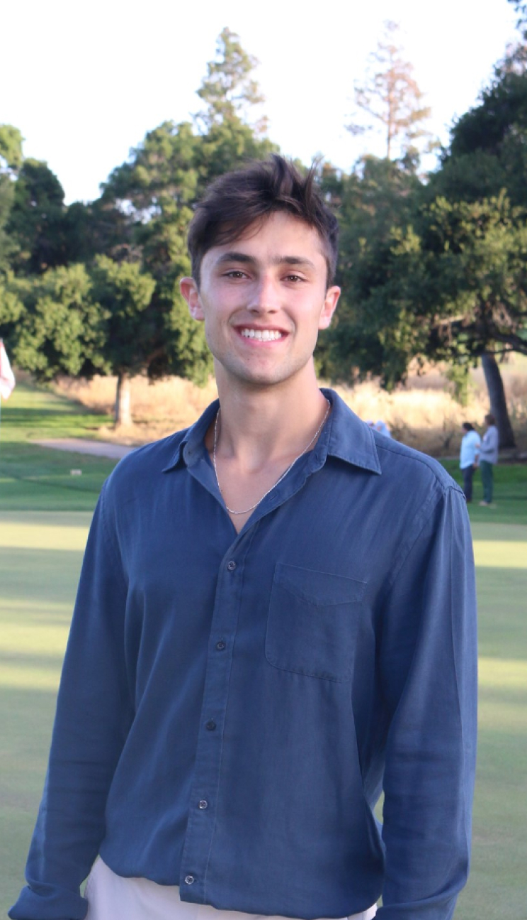
INTRO — TEAM
Name: Adam Barry Year: Junior Major: Computer Science (HCI)
Name: Amy Chang Year: Junior Major: Computer Science (HCI)
Name: Ethan Hellman Year: Senior Major: Computer Science (AI)
Name: Brendan McLoughlin Year: Senior Major: Computer Science (HCI)

Slide 3
Problem Domain
What does an active and fulfilling lifestyle mean to individuals of retirement age, and how might we help facilitate this way of life?

Slide 4
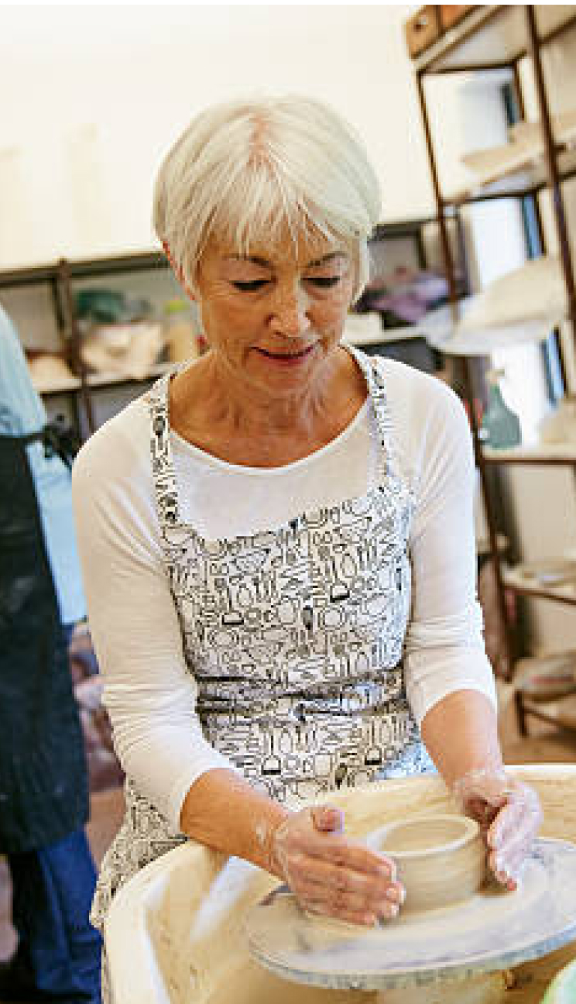

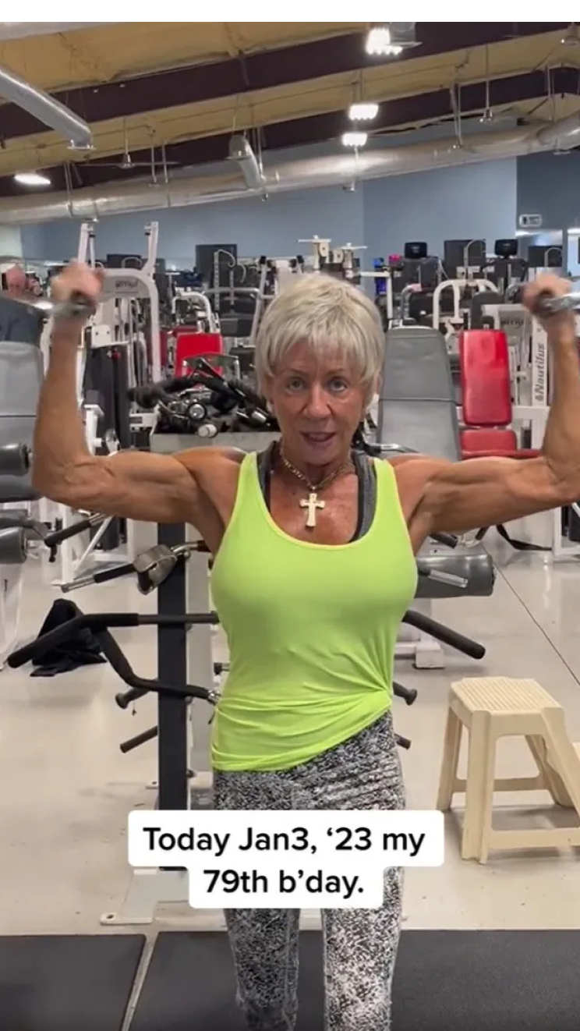
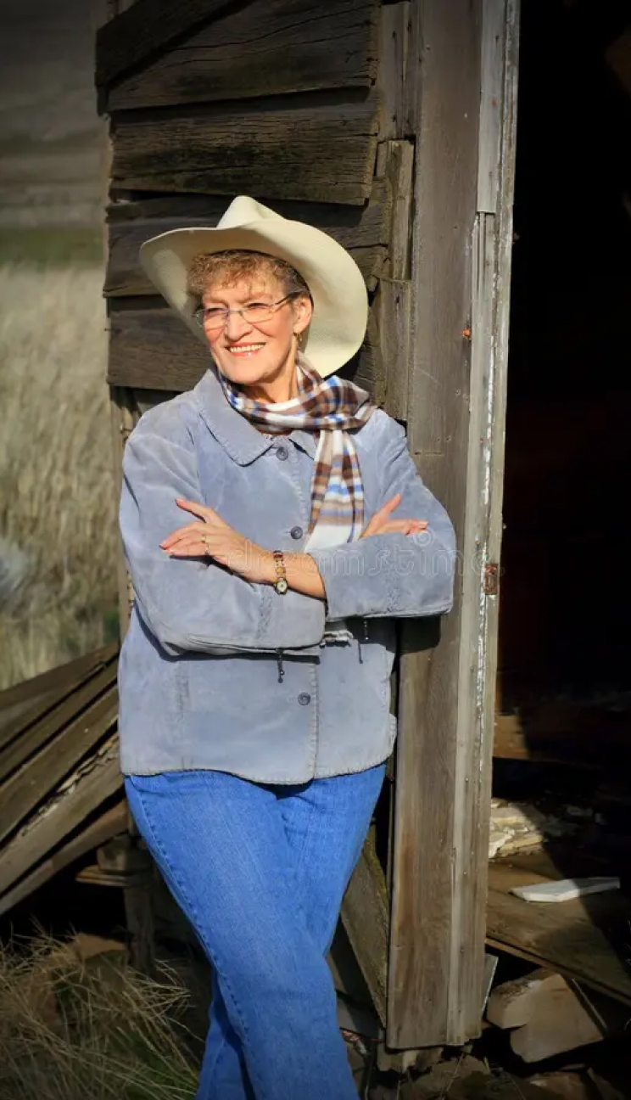

METHODOLOGY — PARTICIPANTS
Gail (78)
Mary-Lue (80)
Robin (77)
Marie (82)

Slide 5
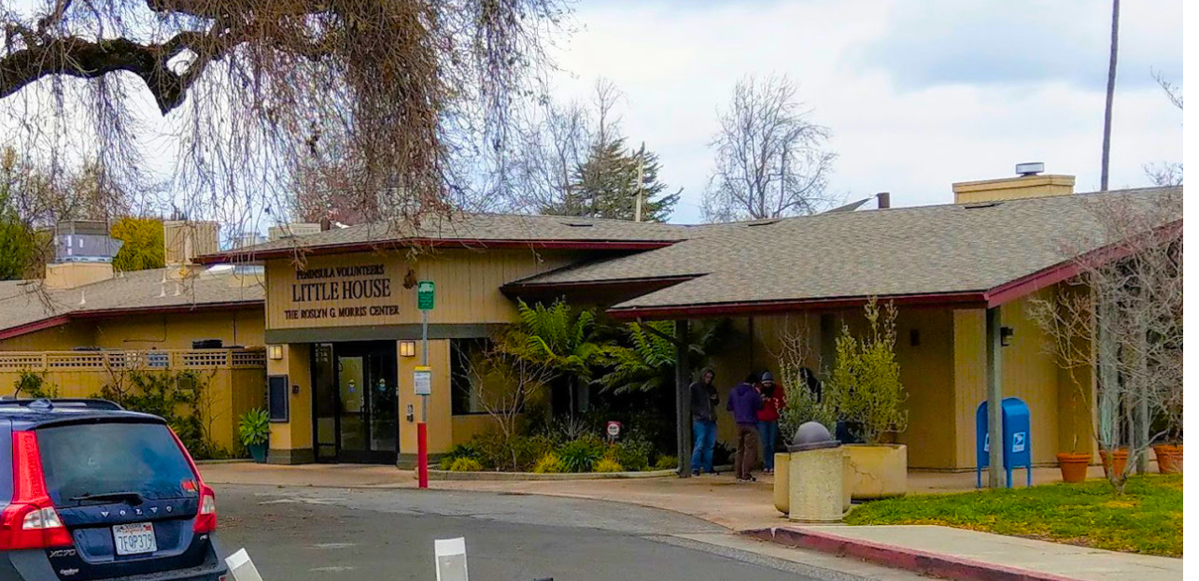
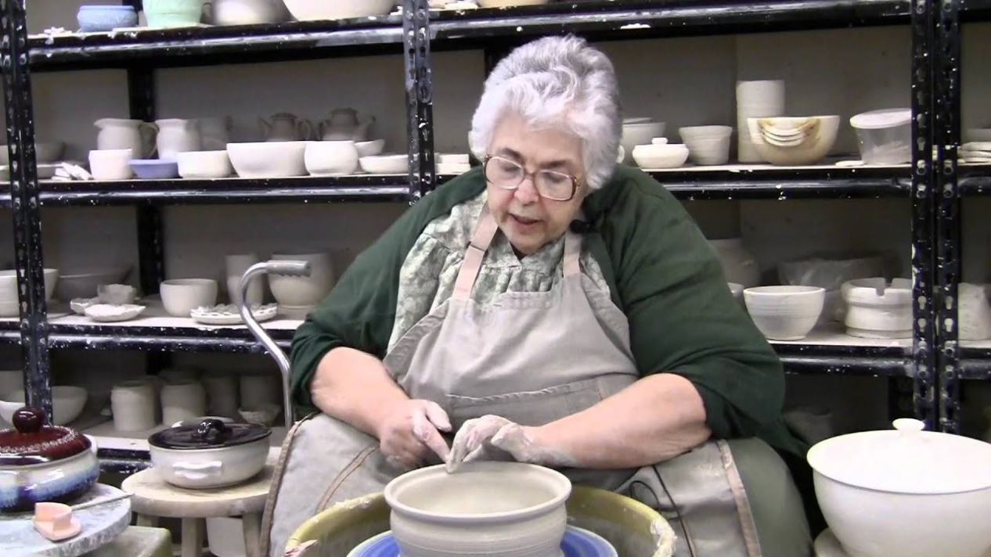
METHODOLOGY — WHERE & WHEN
Little House Activity Center
“Strive to empower older adults with the freedom to stay active in their community...lead independent lives, and continue to get the most out of life.” Offers a variety of health and wellness services to enrich lives of seniors: Fitness & Wellness, Arts & Technology, Social Activities & Games Serves seniors with a variety of backgrounds: those recovering from hospitalisation, with disabilities or age-related illness, below the federal poverty level, or simply facing the challenge of aging.

Slide 6

METHODOLOGY — WHERE & WHEN
Menlo Park Library
Public space providing access to books, computers, internet, etc. dedicated to the pursuit of active lifelong learning. Public libraries often serve as a community hub where people of all ages can gather, interact, socialise. Offers potential for volunteering opportunities serving as a good way to engage seniors.

Slide 7




Key Inquiries
How do you define an active and fulfilling lifestyle”?
How has your perception of an active and fulfilling lifestyle changed as you have eased into retirement?
What is something new you have tried recently?
Can you tell us about a particularly (not) fulfilling day you had recently?
Do you have any plans for the future? What is something that you are excited about?
Walk me through a day in your life in detail.

Slide 8

METHODOLOGY — EXTREME USER
Robin
Stanford ‘68, CS Major Former HP engineer Prefers not to use the internet now! Does not have an email address Fatigued, skeptical, and negative outlook on life Lost all her loved ones during COVID After losing all of her seemingly healthy relatives, now believes that a “healthy lifestyle” is essentially pointless. “I have an inactive lifestyle especially since COVID” “My health is not up to me” “I just want to enjoy my days”

Slide 9


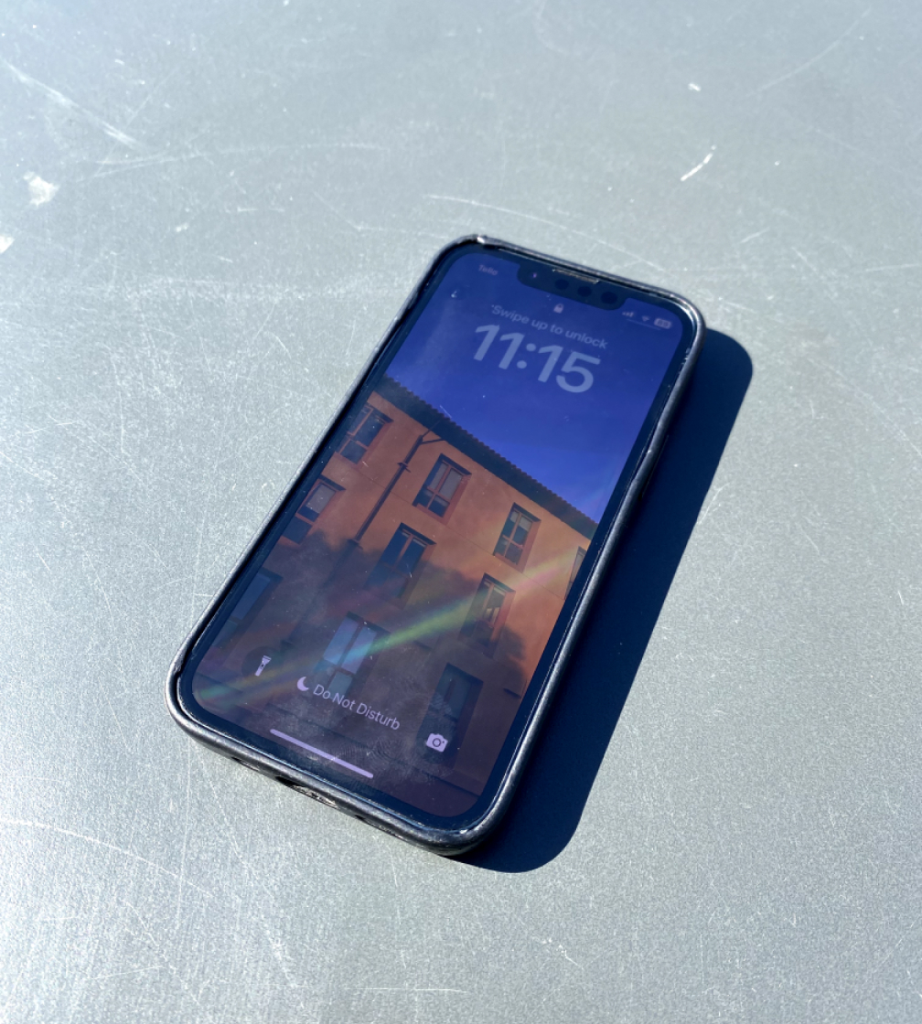
METHODOLOGY — APPARATUS
+ A NICE SMILE & A GOOD ATTITUDE

Slide 10


Key Quotes and Surprises
Disassociation
Inactivity
Lack of Control
“
“
“
I’m not the usual person who comes in here.
I have an inactive lifestyle especially since Covid-19.
[my health] is not up to me.
”
”
”
Even-Keel Life
Lack of Purpose
Workplace -> Volunteering
“
“
... and then I do it all again the next day!
“
I found it difficult, as I had to hold back more and not express my opinions as much.
My goal now is to enjoy my days.
”
”
”

Slide 11
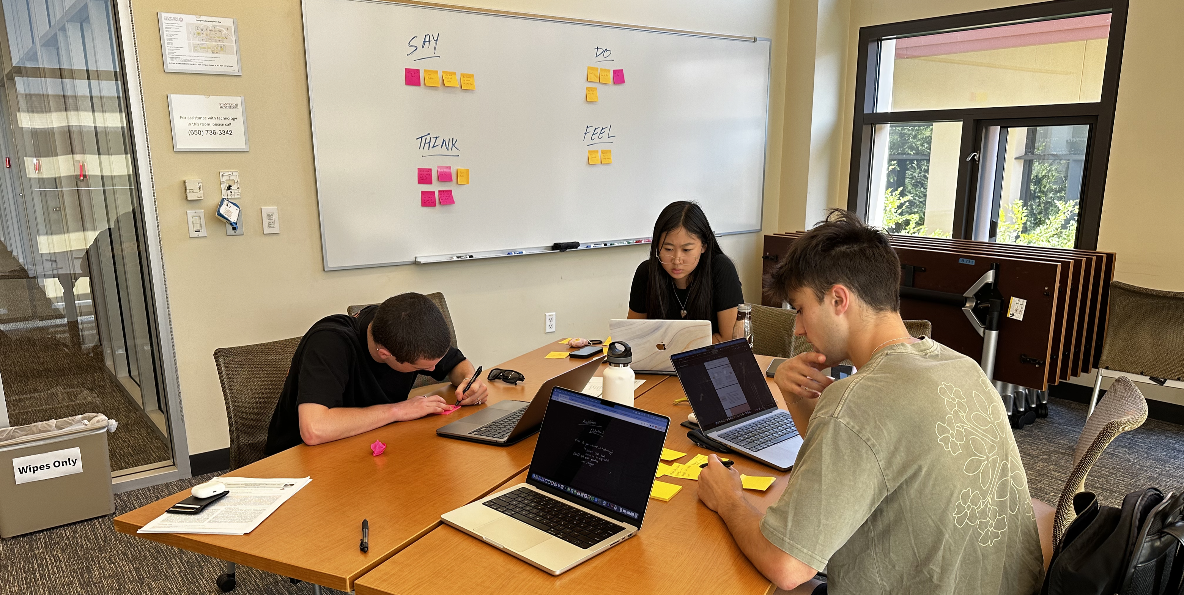
ANALYSIS — EMPATHY MAP — TRUST THE PROCESS

Slide 12
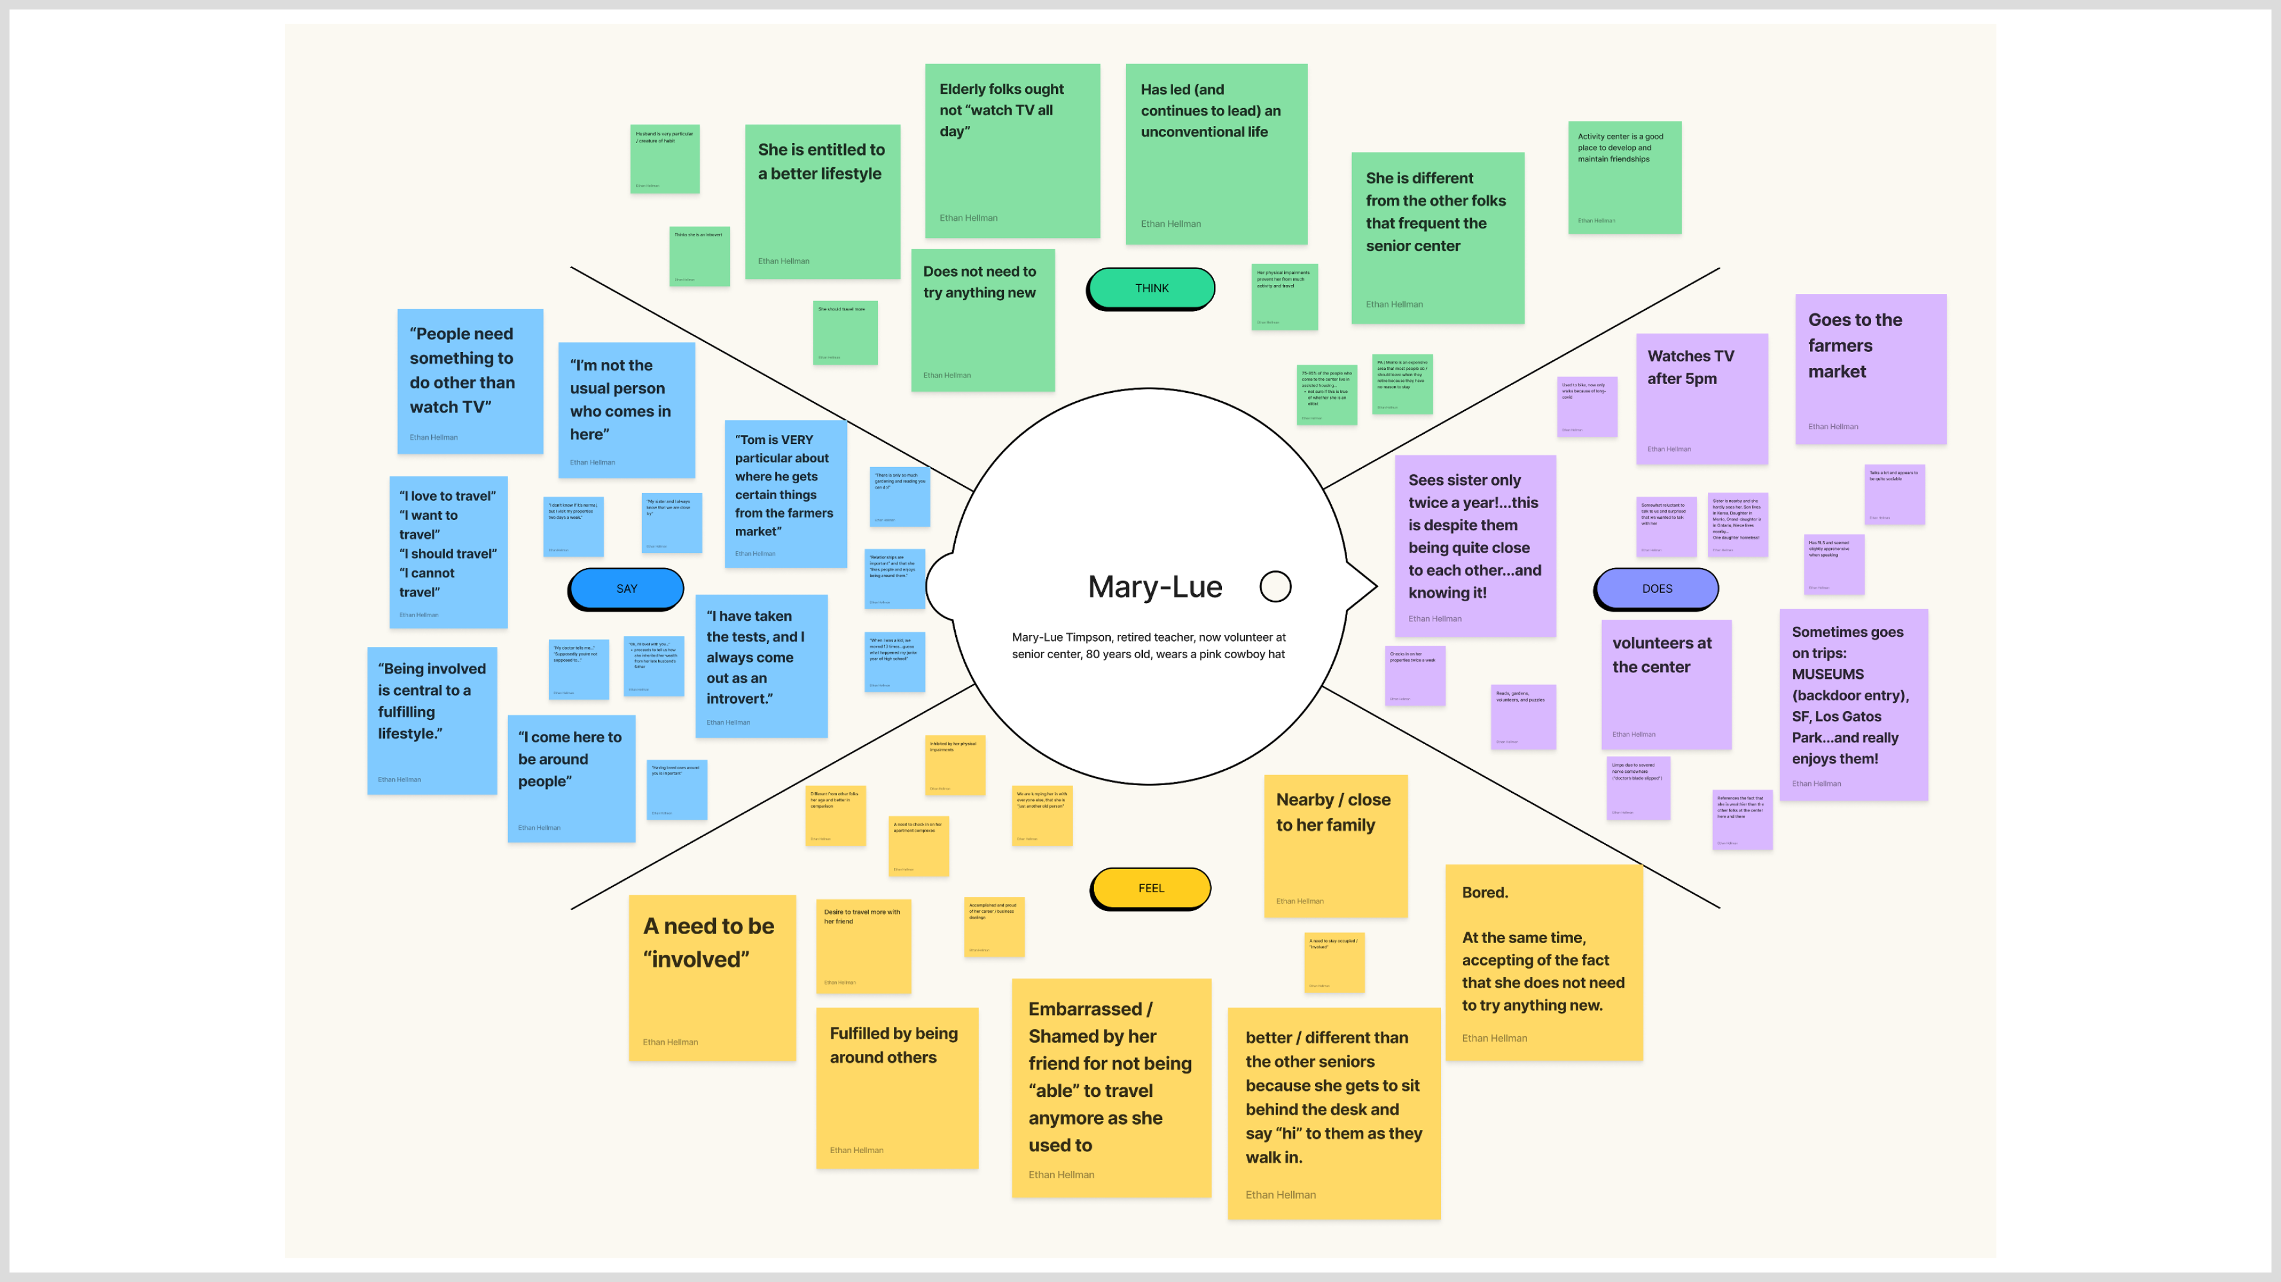

Slide 13
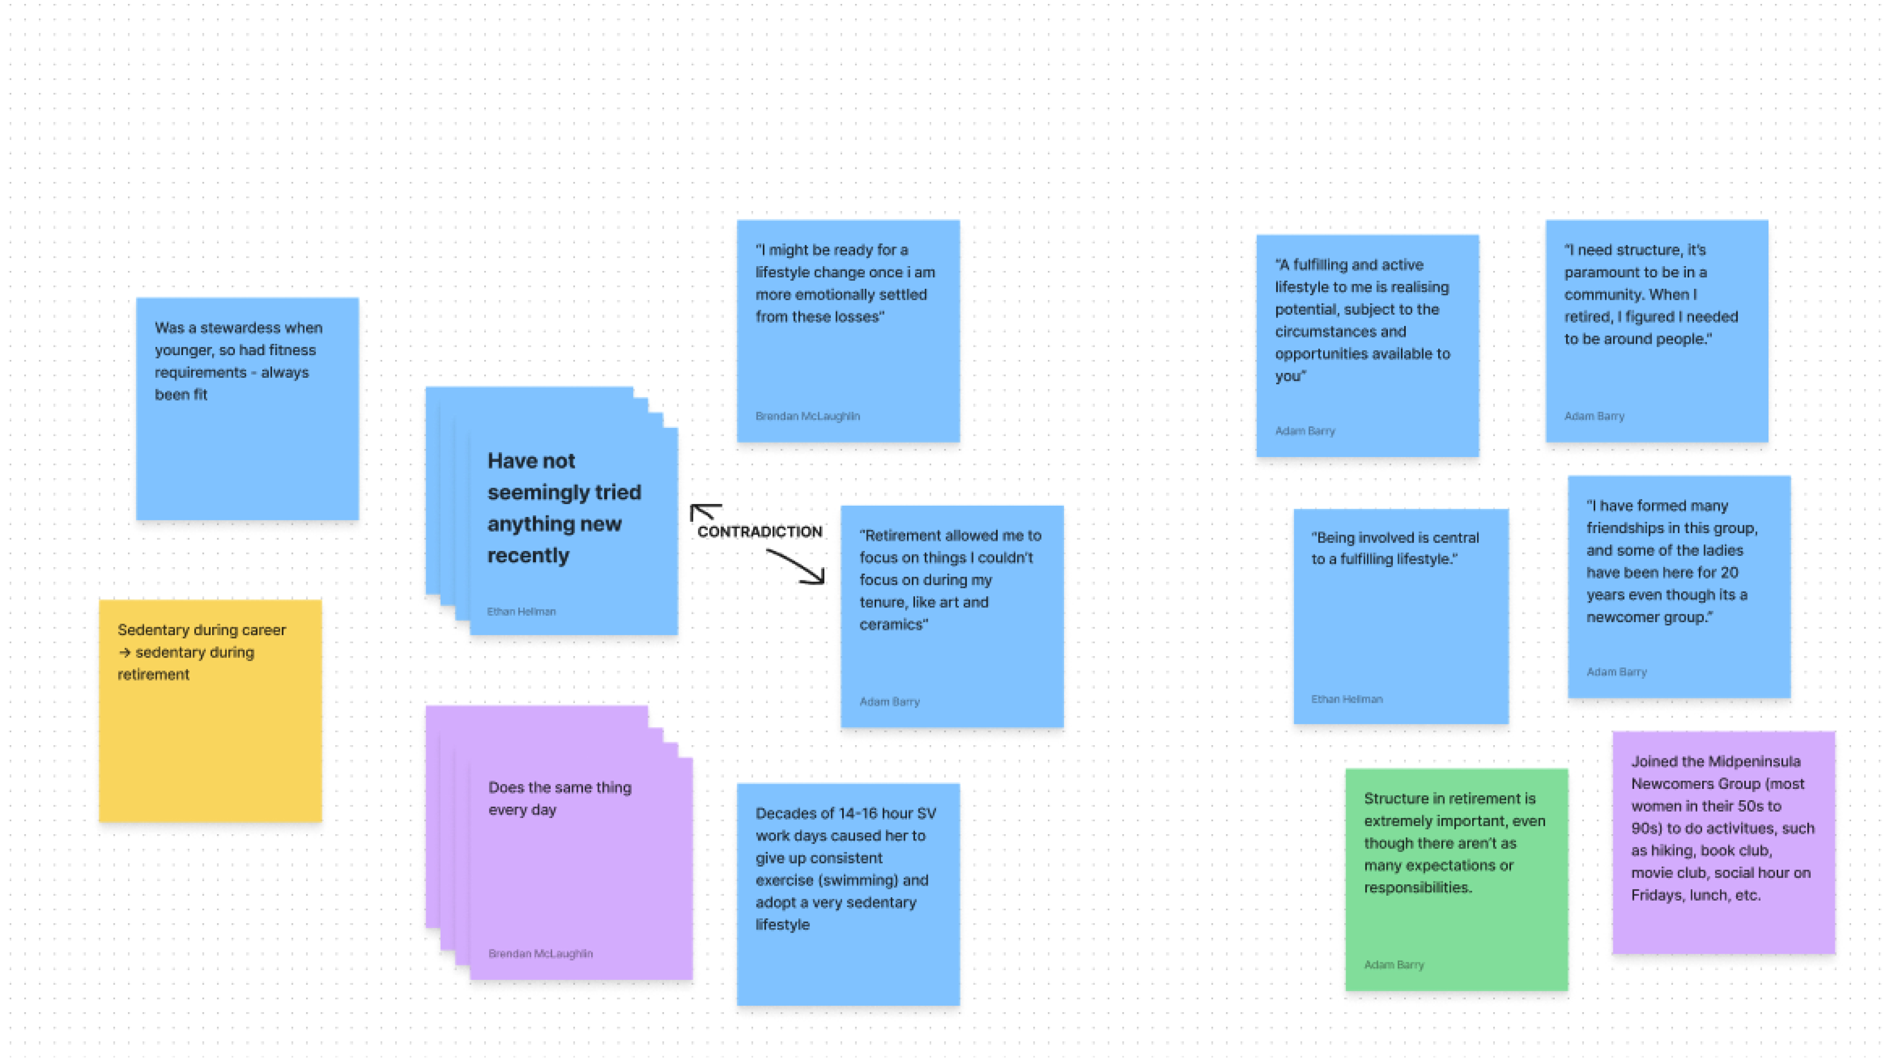
ANALYSIS — SYNTHESIS

Slide 14
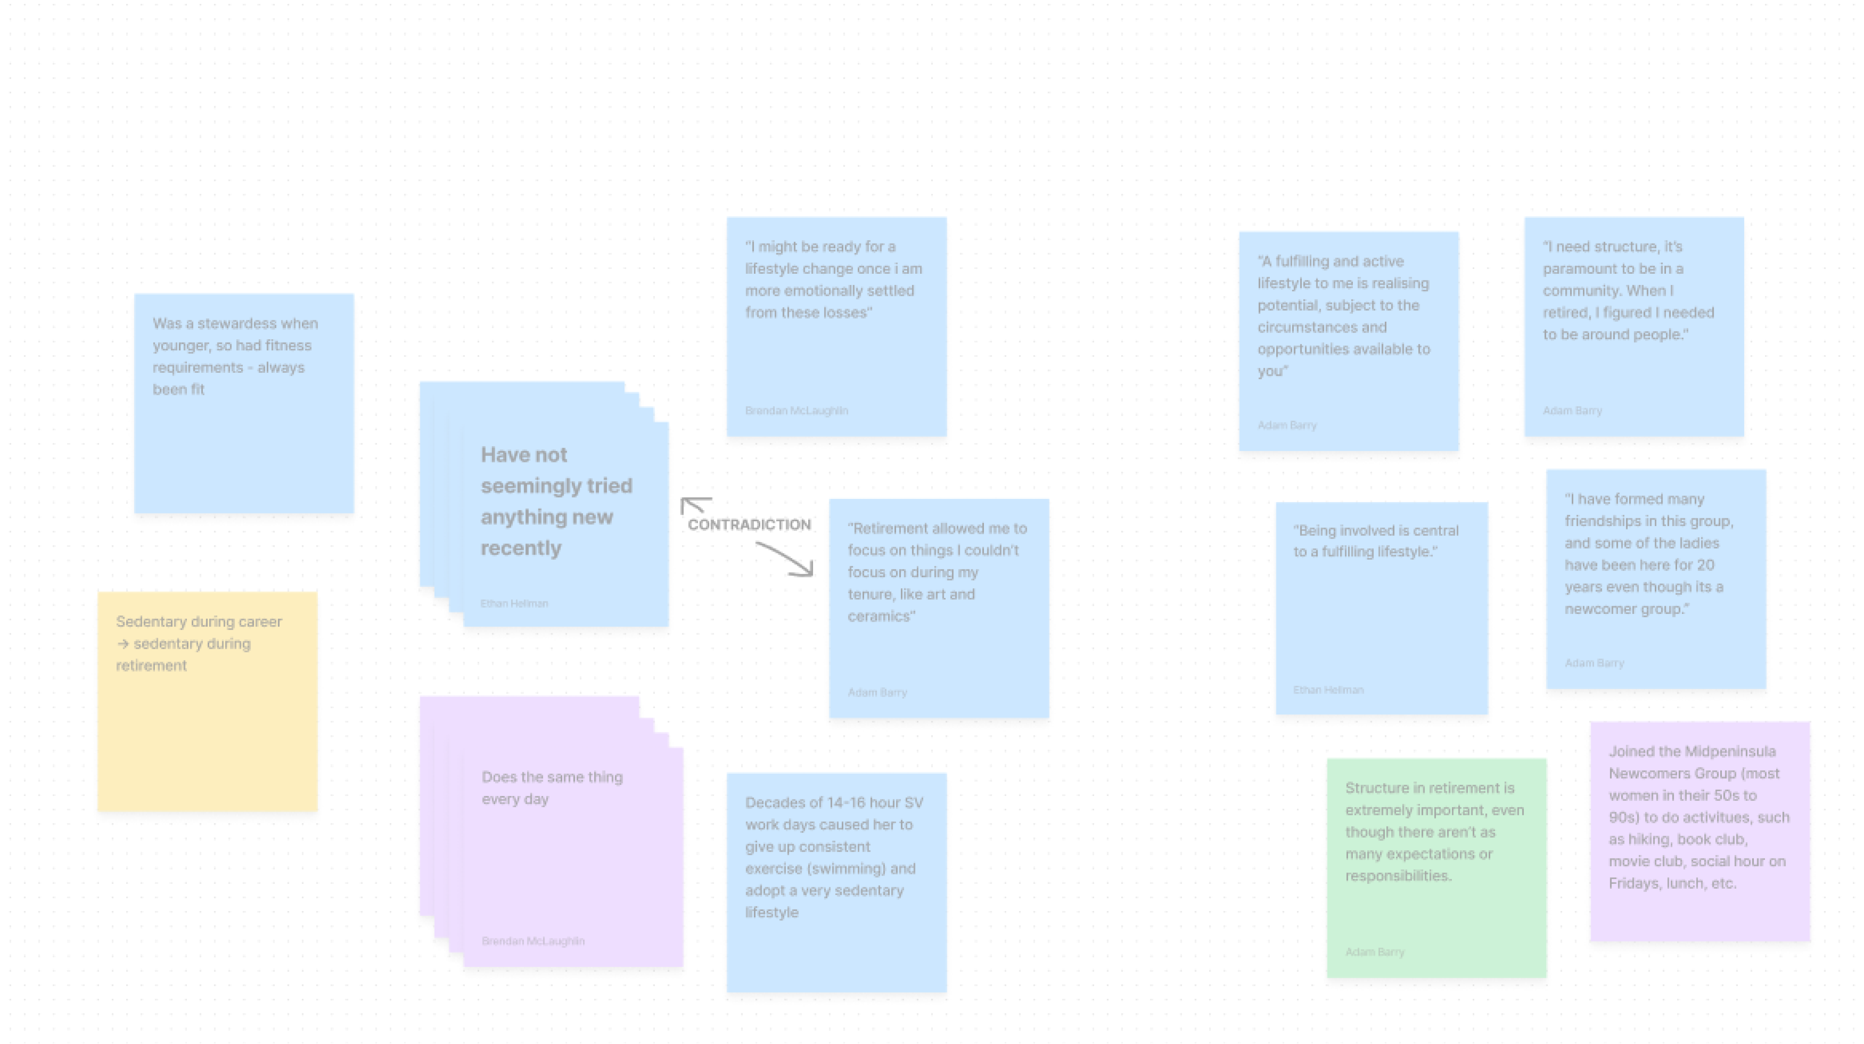
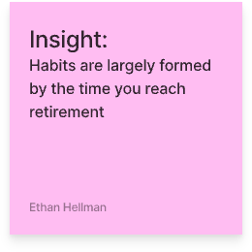
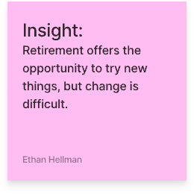
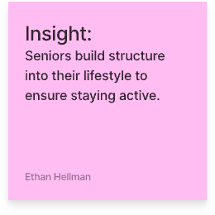
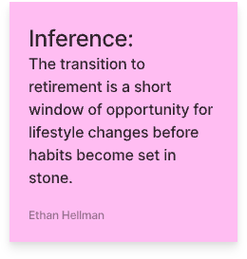
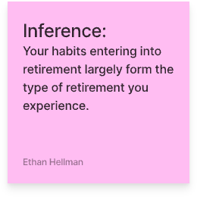
ANALYSIS — SYNTHESIS

Slide 15
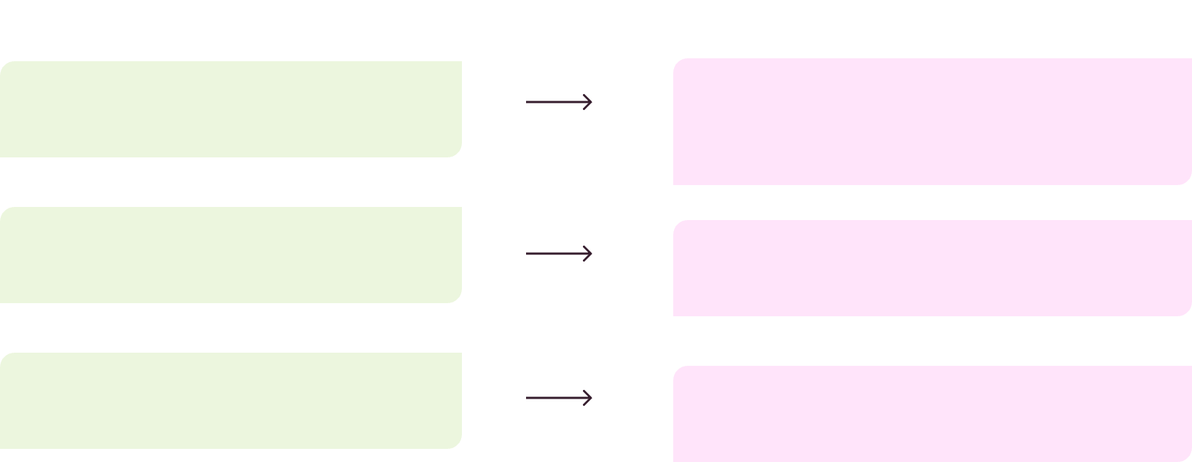
ANALYSIS
Key Insights
Insight
Inference
lightbulb_outline
Habits are largely formed by the time you reach retirement
The transition to retirement is a short window of opportunity for lifestyle changes before habits become set in stone
lightbulb_outline
Seniors build structure into their lifestyle to ensure staying active
Your habits entering into retirement largely form the type of retirement you experience
lightbulb_outline
Retirement offers the opportunity to try new things, but change is difficult
Begin changing habits and attempting new things early into retirement before your routine is set

Slide 16
SUMMARY
Key Learnings
Engagement
Diversity
Commonalities
Elderly people are generally quite willing to engage with us and sacrifice their time! It was quite easy to tag along with what our interviewees were doing - most of them were seated with limited activity. How might we engage participants in places where they are more actively engaged with something?
One drawback was a glaring lack of diversity. Our sample population primarily consisted of white women. We can and should certainly strive to engage a more representative cohort.
It would appear that some of our key questions garnered largely similar responses. Perhaps we can tweak our questions to dig at something deeper... How can we do better to get our participants to tell us stories?

Slide 17
SUMMARY
What’s Next?
Analysis
Iteration
Interviews
Further unpack the content from our existing interviews to better understand our “users.” Start using our data to build out PoV’s. Understand key insights in more depth.
Use our analysis to supplement approach for further research. Iterate on our script so as to pull at key areas of interest and tighter scope. Design questions to provide more room for story-telling
Go to new places to find potential interviewees. Ideas: dog park, farmers market, gardens, local events, religious or spiritual institutions... Seek out a more representative sample population - look for elderly men and ethnically diverse population. Try and engage interviewees while they are actively doing something... Collect more artifacts!

Slide 18
Appendix
Nothing to report!

